Slide 1

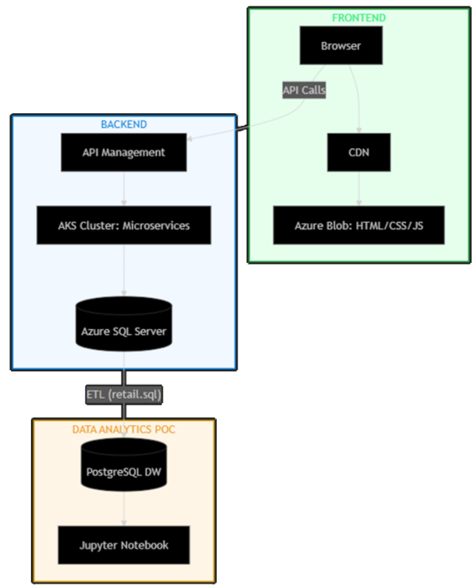
Data-Driven Growth: Bridging the Gap for London Gift Shop
An Analytical Proof of Concept (PoC) for Precision Marketing & Revenue Recovery
Presented by: Sumiksh Trehan, Data Engineer, Jarvis Consulting

Slide 2


EXECUTIVE SUMMARY
Precision Marketing for Stagnant Growth
Engineered a containerized Docker/PostgreSQL ETL pipeline to sanitize 1 million (1,067,371) transaction rows. Processed a comprehensive two-year dataset spanning from December 1, 2009, to December 9, 2011, neutralizing skewed data and negative quantities to ensure a high-fidelity analytical foundation.
Core Finding
Strategic Pivot
852 "Champions" drive LGS profit
71 high-value "Whales" are at immediate churn risk, indicating a critical revenue leak.
LGS must transition from generic tactics to a tiered VIP strategy
Notes:
LGS must transition from generic tactics to a tiered VIP strategy; the current "one-size-fits-all" approach wastes marketing budget on low-value segments.

Slide 3
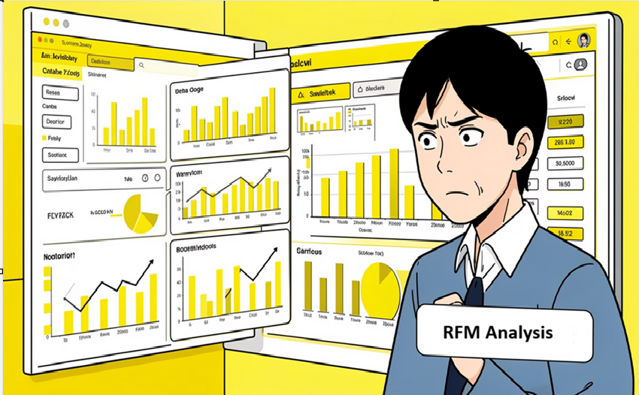
BUSINESS CONTEXT
Addressing the Problem: Stagnant Revenue & Data Gaps
For a decade, London Gift Shop has experienced stagnant revenue.
The Problem: Stagnant revenue despite a decade of operation. LGS relies on "gut feeling" marketing rather than data-driven evidence.
The Gap: A total disconnect between the analytics and the marketing team's strategy.
Measurable Goals for Data-Driven Solutions
Segment Customers
Recover Wholesalers
Inventory Management
Notes:
For a decade, London Gift Shop has experienced stagnant revenue, largely due to marketing strategies based on "gut feeling" rather than data-driven evidence. This lack of insight has led to inefficiencies and missed opportunities.
The Problem: Stagnant revenue despite a decade of operation. LGS relies on "gut feeling" marketing rather than data-driven evidence.
The Gap: A total disconnect between the production cloud (Azure) and the marketing team's strategy.
Segment Customers
Define the value of every customer using RFM logic to understand their engagement and spend patterns.
Recover Wholesalers
Identify and target "At-Risk" high-value wholesalers with precision
re-engagement campaigns.
Inventory Management Identify the sales pattern to stop running out of inventory.

Slide 4
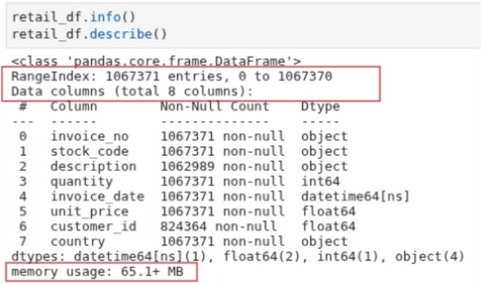
DATA ENGINEERING
Dataset Overview & Data Engineering
Dataset Scale & Structure
Total Volume: 1,067,371 transaction records across 8 relational dimensions
Resource Footprint: Approximately memory usage: 65.1+ MB in-memory
Data Quality Observations
Integrity Gaps: significant missing values in the Customer ID
Operational Noise: Detected approximately 19,000 cancellations
Data Transformations (The "Sanitization" Pipeline)
Executed Type Casting across numerical columns to ensure mathematical consistency for Monetary value aggregations.
Generated a derived Revenue column (Quantity × UnitPrice) to serve as the core metric for high-value customer identification.
Notes:
Data Quality Observations:
Identified significant missing values in the Customer ID column, requiring exclusion to maintain the accuracy of the RFM model.
Detected approximately 19,000 cancellations (Invoices prefixed with "C") and negative quantities, which would have falsely deflated revenue metrics if not isolated.
Data Quality Observations
Integrity Gaps: significant missing values in the Customer ID
Operational Noise: Detected approximately 19,000 cancellations
Data Transformations (The "Sanitization" Pipeline)
Executed Type Casting across numerical columns to ensure mathematical consistency for Monetary value aggregations.
Generated a derived Revenue column (Quantity × UnitPrice) to serve as the core metric for high-value customer identification.

Slide 5
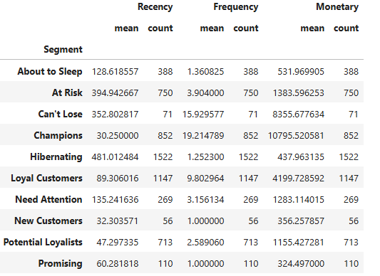
INSIGHT
Key Insights: High-Value
Concentration & Recovery
Opportunity
The Profit Engine - 852 Champions
Finding (WHAT):
Elite Tier: Profitability is driven by 852 "Champions".
High Engagement: Mean spend of £10,795.52 with purchases every ~30 days.
Analytical Evidence (HOW):
Key Stat: 852 Champions represent the backbone of net profitability
Business Impact(WHY):
Revenue Growth: Protecting Champions through "White Glove Service"
Notes:
The Profit Engine - 852 Champions
Finding (WHAT):
The core of London Gift Shop's profitability is driven by a small elite tier of "Champions" with a mean spend of £10,795.52 and remarkable engagement (purchasing every ~30 days).
Analytical Evidence (HOW):
Metric: Identified Champions as the highest-value segment with consistent, high-frequency purchases
Key Stat: 852 Champions represent the backbone of net profitability
Business Impact(WHY):
Revenue Growth: Protecting Champions through "White Glove Service" is crucial- 5% retention increase among Champions is more valuable than acquiring 1,000 new retail customers
Strategic Priority: These elite customers are the most stable revenue source
The Churn Risk - 71 "Can't Lose" Whales
Finding (WHAT):
A critical revenue leak: 71 high-value "Can't Lose" customers have historically shopped ~16 times with an average spend of £8,355.68 each but have been silent for 352.8 days - representing over £590,000 in latent lifetime value at risk.
Analytical Evidence (HOW):
Method: Combined RFM Scoring with Outlier Analysis on the 1.06M row dataset
Metric: Identified the delta between active Champions and dormant high-value accounts
Key Stat: High monetary value combined with significantly low recency scores (352.8 days) indicates strong likelihood of churn
Business Impact (WHY):
Revenue Recovery: An immediate "Win-Back" campaign targeting these 71 accounts is the fastest way to recover £590,000+ in latent capital without the high cost of new customer acquisition
Cost Reduction: Reactivating existing high-value customers is exponentially cheaper than acquisition

Slide 6
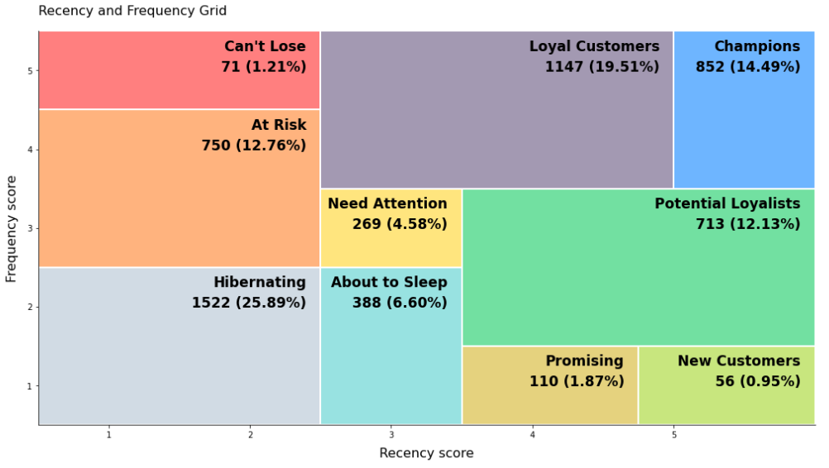
INSIGHT
Key Insights - Continued
The Churn Risk - 71 "Can't Lose" Whales
Finding (WHAT):
71 High-Value Leads: High frequency (~16 orders) and high spend (£8,355 avg).
Critical Silence: No activity for 352.8 days.
Analytical Evidence (HOW):
Churn Indicator: High monetary value vs. critically low recency.
Business Impact (WHY):
Revenue Recovery: Immediate launch of targeted "Win-Back" campaign.
Notes:
The Churn Risk - 71 "Can't Lose" Whales
Finding (WHAT):
A critical revenue leak: 71 high-value "Can't Lose" customers have historically shopped ~16 times with an average spend of £8,355.68 each but have been silent for 352.8 days
Analytical Evidence (HOW):
Key Stat: High monetary value combined with significantly low recency scores (352.8 days) indicates strong likelihood of churn
Business Impact (WHY):
Revenue Recovery: "Win-Back" campaign

Slide 7
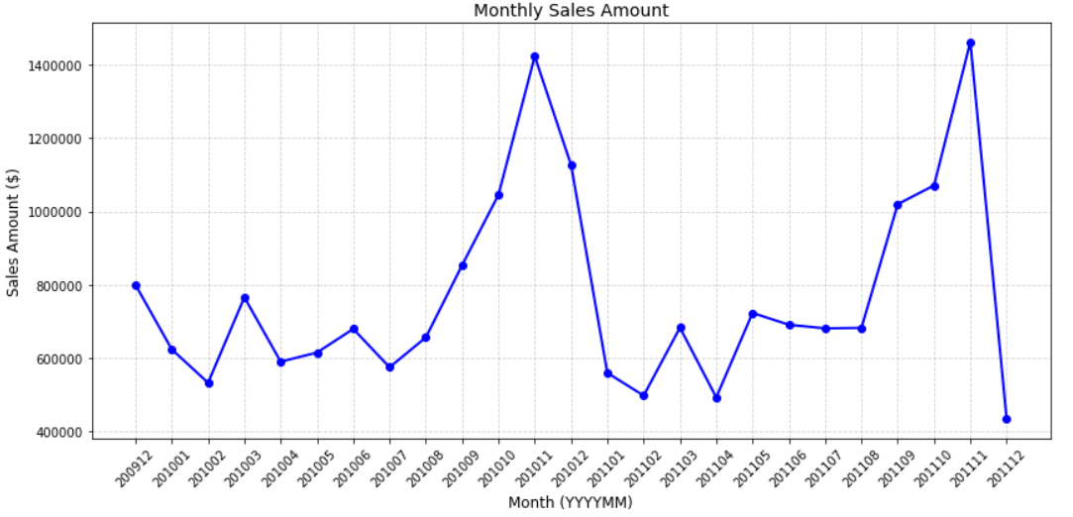
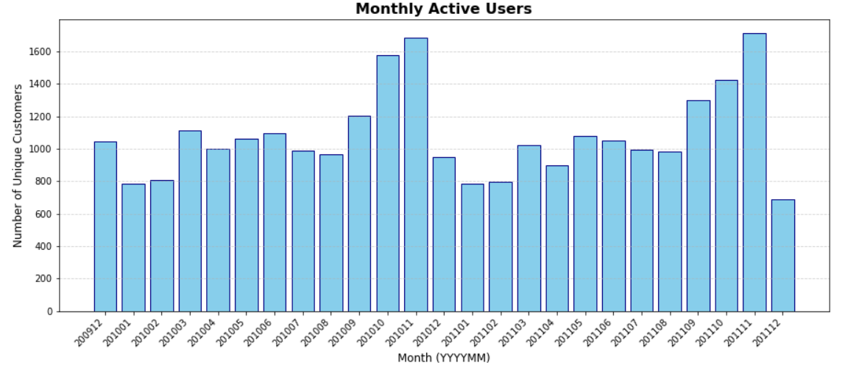
INSIGHT
Key Insights - Continued
Seasonal Volatility & The Retention Economics Gap
Finding (WHAT):
Q4 Revenue Spike: November revenue surges nearly 300%.
Analytical Evidence (HOW):
Low Retention: New customers average 1.0 frequency.
Churn Risk: High drift from "New" to "Hibernating" status.
Business Impact (WHY):
Cost Efficiency: Higher forecast accuracy via Q4 data.
Strategic Shift: Prioritizing "Retention-First" Welcome Journeys.
Notes:
Seasonal Volatility & The Retention Economics Gap
Finding (WHAT):
LGS experiences extreme Q4 revenue surges (peaking in November with nearly 300% increase compared to mid-year average)
Analytical Evidence (HOW):
Metric: Compared November peak against the low Frequency mean (1.0) of the current "New Customer" cohort
Key Stat: While Monthly Active Users (MAU) is healthy. "New Customers" drift toward "Hibernating" status instead of becoming loyal
Business Impact (WHY):
Cost Reduction: Improved forecast accuracy based on Q4 spikes
Marketing Efficiency: Pivoting to a Retention-First strategy - "Welcome Journeys"

Slide 8
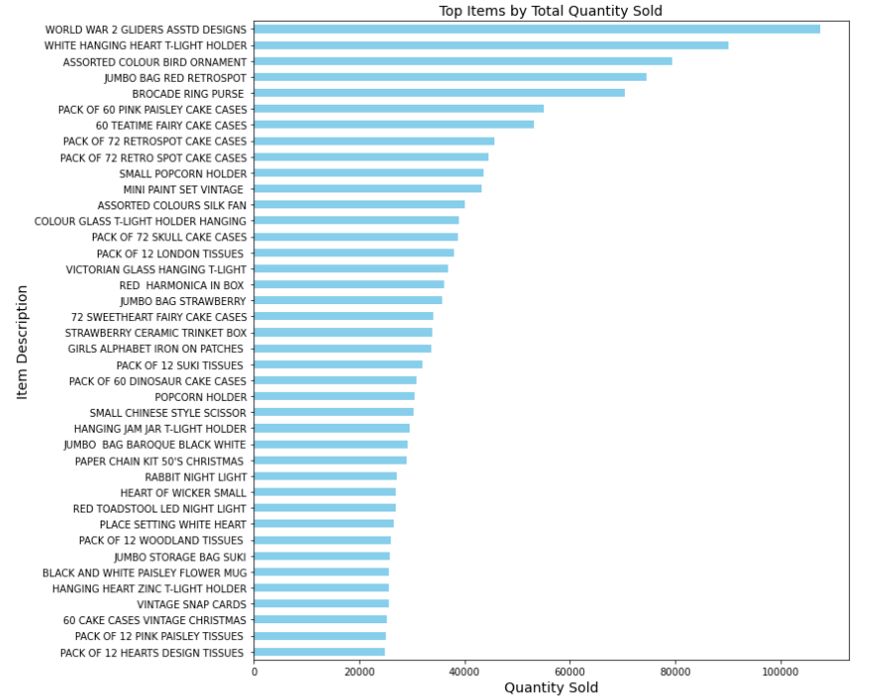
INSIGHT
Key Insights - Continued
Top 40 SKU Inventory Analysis
Finding (WHAT):
Core Stock Drivers: Top 40 SKUs dominate warehouse throughput and velocity.
Analytical Evidence (HOW):
Quantity Summation: Grouped descriptions by total units sold to visualize stock movement.
Business Impact (WHY):
Efficiency Gain: Prioritizing these SKUs for "fast-pick" zones reduces fulfillment latency.

Slide 9
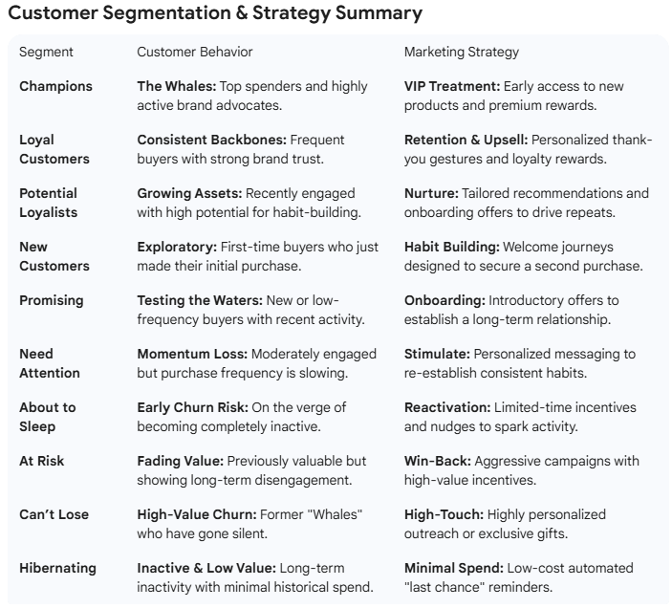
RECOMMENDATION
Recommendations
We are no longer guessing; we are engineering growth.
A. Customer Strategy: Value-Based Retention
VIP Program: "White Glove" service for 852 top spenders.
Churn Recovery: Immediate "Win-Back" for 71 critical accounts.
Retention Onboarding: Automated "Welcome Journeys" for new users.
B. Product Strategy: Inventory & Bundle Optimization
Inventory Loading: Front-load 70% of holiday stock for November.
Bundle Optimization: "Wholesale Bundles" to drive higher AOV.
Notes:
This project has transformed over 1 million rows of raw noise into a 10-tier revenue roadmap. We are no longer guessing; we are engineering growth.
A. Customer Strategy: Value-Based Retention
Tiered VIP Engagement: Establish a "White Glove" program for the 852 Champions (Mean Spend: £10,795.52) to protect the core revenue engine. Target a 5–10% increase in LTV for the top tier.
High-Value Churn Recovery: Launch immediate "Win-Back" campaigns for the 71 "Can't Lose" customers to recover their £8,355.68 latent value.
Retention Onboarding: Implement automated "Welcome Journeys" for New Customers (Mean Frequency: 1.0) to secure the critical second purchase. Target 10–18% improvement in transition rates from New to Loyal.
B. Product Strategy: Inventory & Bundle Optimization
Extreme Seasonal Pre-Loading: Front-load 70% of holiday inventory by August/September to prepare for the November revenue surge. Target 20% reduction in stockouts during peak Q4 sales.
High-Velocity Bundling: Create "Wholesale Bundles" for top-performing SKUs to increase Average Order Value (AOV) for Potential Loyalists.

Slide 10




ROADMAP
Strategic Roadmap for Sustainable Growth
Our recommendations outline a phased approach to leverage data insights for targeted marketing and long-term customer engagement.
Customer Strategy
Move "Potential Loyalists" into "Loyal" tiers through personalized "Next-Purchase" recommendations, fostering consistent engagement.
Short-Term (0-3 Months)
Build marketing-facing dashboards for real-time performance monitoring using Power BI , Tableau or cloud resources.
Medium-Term (3-12 Months)
Deploy Machine Learning models for Predictive Churn Detection, enabling proactive intervention for at-risk customers.
Long-Term (12 Months+)
Execute a full migration to a live Spark/Databricks pipeline, facilitating real-time personalization and advanced analytics capabilities.
Notes:
1.7.2013
9
‹#›

Slide 11
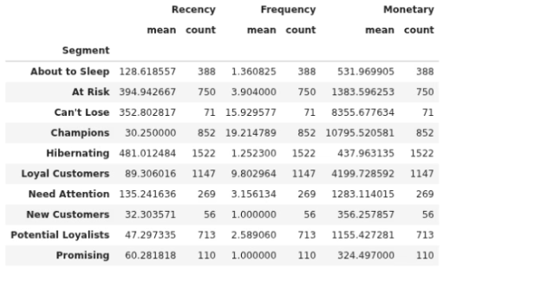
ANALYTICS METHODOLOGY
RFM Analysis: Unlocking Customer Value
We employed a robust RFM (Recency, Frequency, Monetary) analysis framework to segment customers, ensuring a data-driven approach to understanding their value and behavior.
Analytical Framework
Our analytical framework moves from generic observations to specific behavioral intelligence by addressing key business questions:
Customer Lifetime Value, Retention Risk, Purchasing Velocity
Techniques Used
RFM Segmentation (Recency, Frequency, Monetary)
Quintile-Based Ranking
Recency (R): Days elapsed since last purchase, anchored to Jan 1, 2012 snapshot date.
Frequency (F): Counted unique invoice IDs per customer to measure actual visit counts.
Monetary (M): Sum of line_total (Quantity × Price) for every transaction.
Applied 1-to-5 scoring using statistical distribution (q-cut) to normalize customer behavior for fair comparison.
Cohort Tagging
Anomaly Neutralization
Logic to distinguish "New" vs "Existing" users per month to evaluate acquisition vs. retention efficacy.
Isolated and removed negative quantities, zero-price entries, and missing Customer IDs to ensure data integrity.
Analytical Rigor & Validation Protocol
Outlier Management: Applied 85th-percentile filtering to prevent extreme data points from skewing metrics.
Data Integrity: Addressed 19,000+ cancellations (prefixed with 'C') by subtracting them from placed order counts.
Standardized Benchmarks: Every insight based on clearly described calculations across 1M+ rows of cleaned data.
Reproducibility: Entire process managed within a containerized Docker environment for zero-variation replication.
Notes:
5

Slide 12
STRATEGIC RECOMMENDATIONS
Strategic Roadmap for Sustainable Growth
Customer Strategy: Value-Based Retention
Tiered VIP Engagement: Establish a "White Glove" program for the 852 Champions (Mean Spend: £10,795.52) to protect the core revenue engine. Target a 5–10% increase in LTV for the top tier.
High-Value Churn Recovery: Launch immediate "Win-Back" campaigns for the 71 "Can't Lose" customers to recover their £8,355.68 latent value. Recover approximately £60,000 in dormant revenue in Q1.
Retention Onboarding: Implement automated "Welcome Journeys" for New Customers (Mean Frequency: 1.0) to secure the critical second purchase. Target 10–18% improvement in transition rates from New to Loyal.
Projected 15% lift in AOV for mid-tier segments.
Low-Performance Pruning: Use the 85th-percentile filter to identify and reduce stock for SKUs only purchased by Hibernating users. Optimize warehouse space and reduce carrying costs.
C. Geographic Strategy: Market Prioritization
UK-Centric Precision: Focus high-density promotions on high-spending UK regions with growing demand spikes. Improved marketing ROI by reducing broad-market waste.
International Expansion Identification: Isolate the top 5% of non-UK spenders to test localized marketing in those regions. Evidence-based expansion into secondary markets.
D. Operational Strategy: Data Integrity & Scalability
Standardized Cancellation Tracking: Modernize the "C" prefix taxonomy in the production database to improve net-revenue forecasting accuracy. Eliminate the £1,383.60 potential skew identified in the "At Risk" segment.
Unified Product Taxonomy: Deploy the Jupyter-based cleaning logic to the production SQL Server to standardize product descriptions across 1M+ rows. 20% improvement in cross-categorical analysis accuracy.
Pipeline Productionization: Transition the PoC Docker environment to an Azure Data Factory stream for real-time marketing insights. Reduction of manual engineering effort by 20 hours per month.
Notes:
7

Slide 13
RISKS & MITIGATIONS
2.9 Risks, Limitations & Mitigations
Risk Categories & Current Limitations
Data Quality Constraints
Inconsistent and incomplete product descriptions across 1M+ rows required extensive pre-processing
Scalability Bottlenecks
Pandas-based pipeline efficient for 110MB PoC but will face memory limits at production scale
Anonymity & Lack of PII
Dataset lacks PII, limiting segmentation to behavioral cohorts only
Revenue Distortion via Cancellations
19,000+ "C" prefixed transactions represent returns/cancellations that inflate revenue
Temporal Sampling Bias
Two-year window (Dec 2009-Dec 2011) may not account for long-term shifts or post-pandemic behaviors
Strategic Mitigations & Future-Proofing
Unique Product Master Tables
Relational product catalog for standardized descriptions
Enhanced Event Logging
Real-time event tracking instead of static SQL dumps
Hashed Customer Identifiers
Secure hashed PII for cross-channel tracking with privacy compliance
Multi-Source Integration
Merge transactional data with web traffic and marketing spend for holistic ROI view
Notes:
9

